Slide 1
SPEAKING QUESTION 4 & 6
TOEFEL

Slide 2



Slide 3
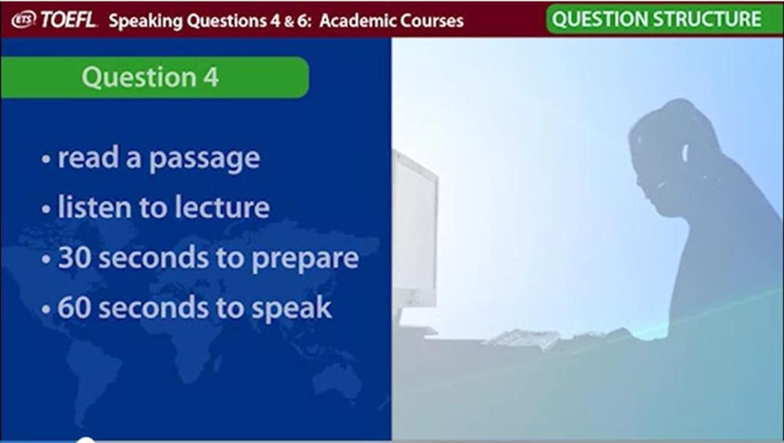

Slide 4


Slide 5
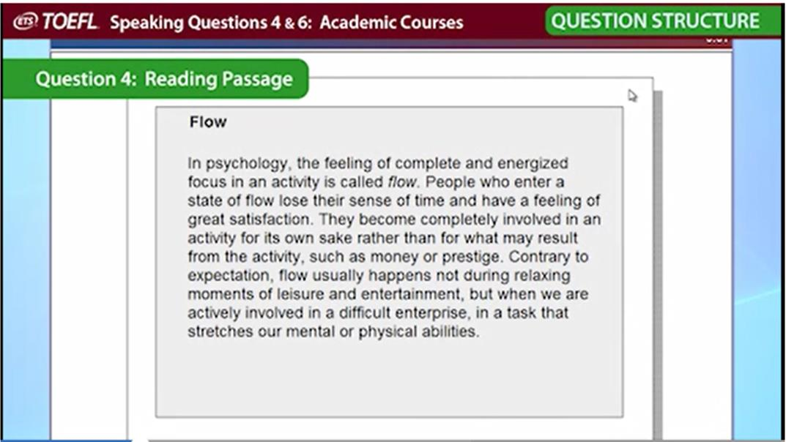
Notes:
Reading passage will be from Academic course material, mainly on science and technology which you have read in 1st year or 2nd year.

Slide 6
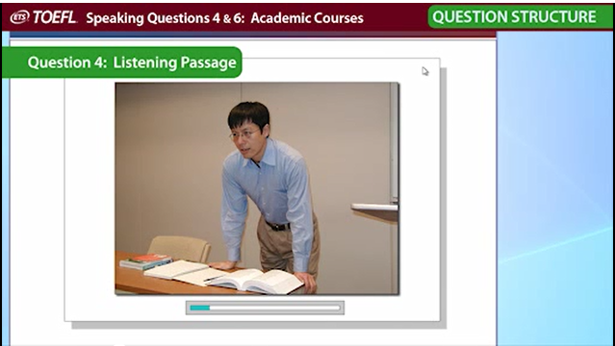
Notes:
In the lecture you will get detail picture on the subject which was there on the reading passage.

Slide 7
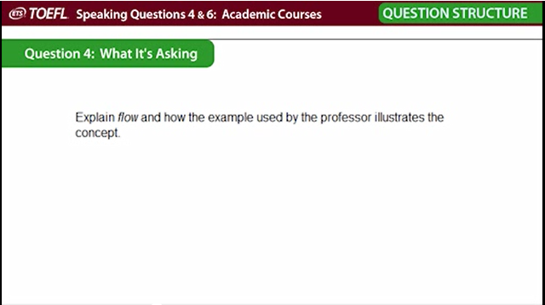

Slide 8
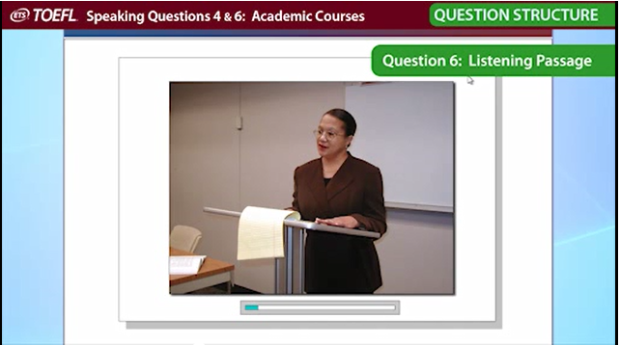
Notes:
The lecture will be on academic teaching, defining a concept or highlighting an issue.

Slide 9
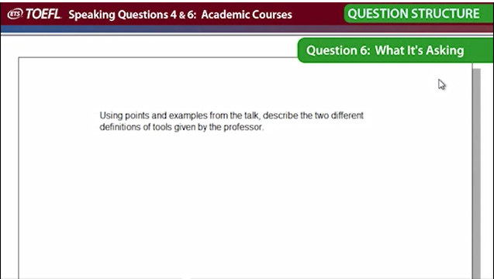

Slide 10
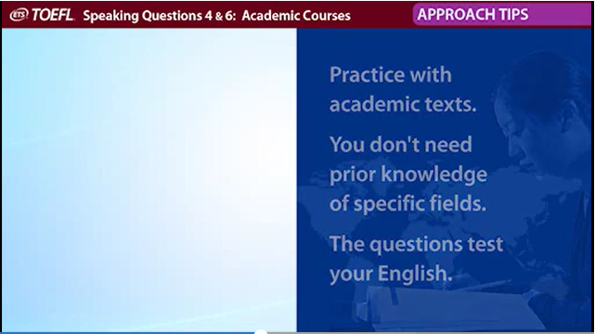

Slide 11
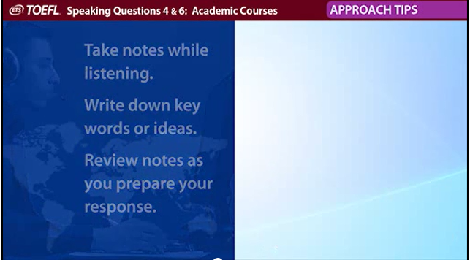

Slide 12
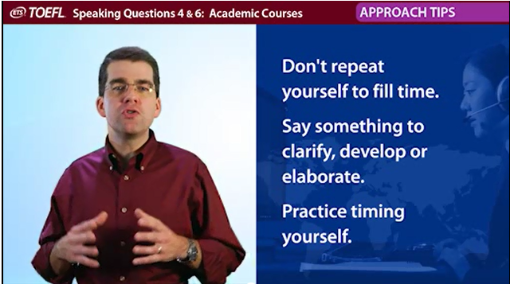

Slide 13
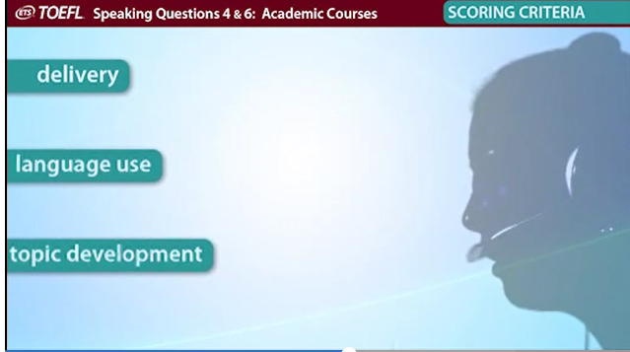

Slide 14
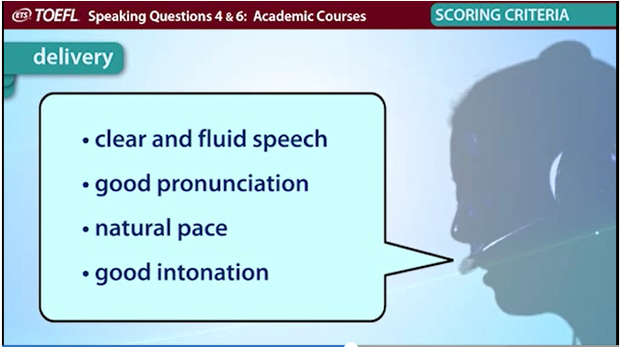

Slide 15
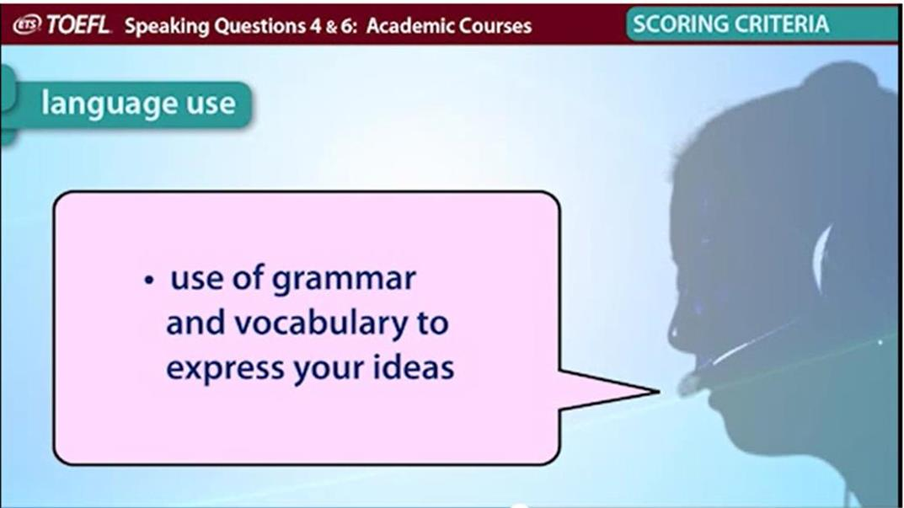

Slide 16
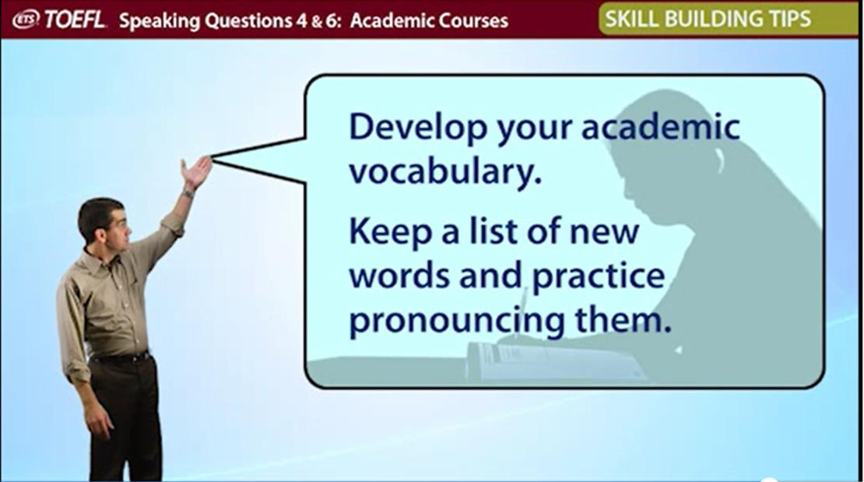

Slide 17
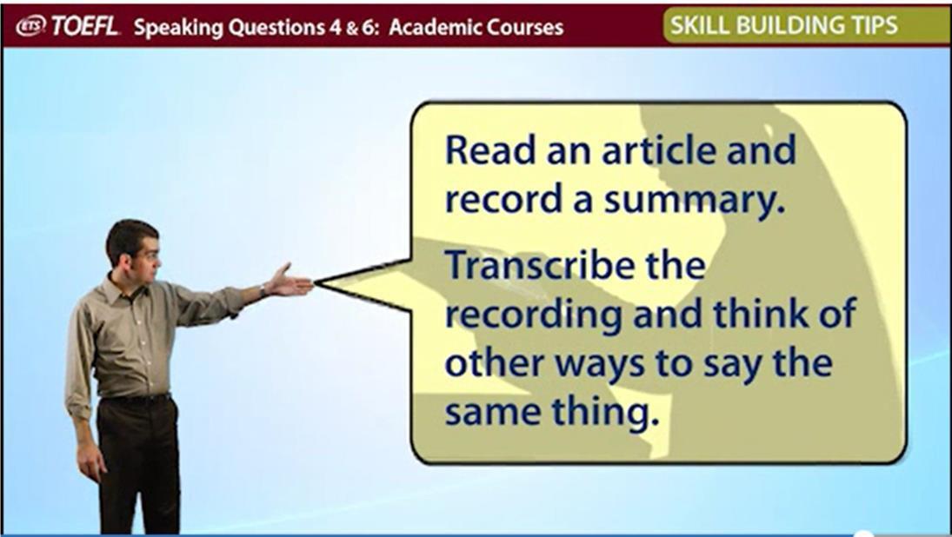

Slide 18
